Slide 1
PROMOTING CHILDREN’S BILINGUAL SKILLS
PROMOVIENDO LAS HABILIDADES BILINGÜES DE LOS NIÑOS
Xigrid Soto, PhD, CCC-SLP xigridsoto@ku.edu

Slide 2
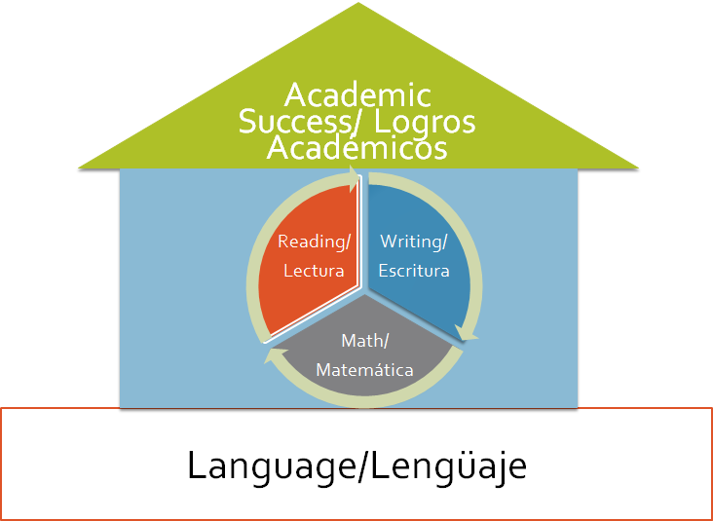
Language is the avenue for learning
El lenguaje es la vía para aprender
Talking is Teaching/El Hablar es Enseñar

Slide 3
Focus on providing…
Enfoquese en proveer…
Rich vocabulary
Opportunities for back and forth communication
Modeling of age-appropriate sentences
Use of visual supports, gestures, and other supports
Intentional use of talking to teach

Slide 4
Modeling
Modeling:
Saying things you want your child to imitate.
Why Does it Work?
Modeling gives children good examples of how to become better communicators.
What do You do?
Model to the child some phrases you want him/her to learn. Wait for their response.
Example:
Adult: “This is a red ball. You say it.”
Child: “This is a red ball.”
Example

Slide 5



Example/Ejemplo:
This is a great strategy for children who are only saying one word in a language.
¿Qué quieres hacer?
Blocks
En español, blocks se llaman “bloques.” Say, “bloques.”
Bloques

Slide 6
Expansion
Expansion:
building and adding to the vocabulary children already know
Why Does it Work?
Expansion gives the children the ability to be exposed to new vocabulary in situations they are already familiar with.
What do You do?
Pay attention to a word or sentence the child says, then expand on it.
Example:
Child: “I see toy”
Adult: “I see your little toy next to the big, green toy on the floor. ”
Example

Slide 7
Example/Ejemplo:
Yes! You see the yellow sunflower with its big leaves.
I see a sunflower!

Slide 8
Repetition
Repetition:
saying and doing the same things over and over to help children learn new things
Why Does it Work?
Repetition allows children to learn the words that they hear frequently.
What do You do?
repeat words during daily activities
Example:
Adult: “What do you put on your feet? Shoes! We wear shoes, we jump in our shoes, and we tie our shoes.”
Example

Slide 9

Example/Ejemplo:
Think about a word or concept you want to teach the child and provide multiple repetitions of that concept/word for the children.
The weather I so cold outside. It’s freezing. I know it gets freezing in the winter. What clothes should we wear when it is freezing outside? What would happen if you wear shorts when it’s freezing outside?

Slide 10
Questions
Questions:
Asking children child questions
Why Does it Work?
Questions encourage children to practice answering questions. This helps their listening skills.
What do You do?
ask children a question you know they will be able to understand and answer with more than a yes or no response
Example:
Adult: “Tell me what you see on the book.” or “What are some things that fly?”
Example

Slide 11
Example/Ejemplo:
If you ask yes or no questions, or wh questions (who, what, where, when), you will get one word answers. The key is to try asking more open ended questions.
We are reading about things we do in the Fall. I like carving pumpkins in the Fall. Tell me about something you like doing in the Fall.

Slide 12
Labeling
Labeling:
Saying the names of things and actions as you are doing them
Why Does it Work?
Labeling helps children learn words and understand what they mean.
What do You do?
Say the name of objects or actions as they occur
Example:
Adult: “Before we sleep, we are going to brush our teeth. Let’s get our toothbrush and put toothpaste on it. We are going to brush, brush, brush so they can be clean.”
Example

Slide 13
Example/Ejemplo:
You can label things throughout the day, not just during storybook reading or Circle Time. Each moment of the day is an opportunity to teach using language.
I see that you are stacking blocks at centers today. Your tower is really high. It is a giant tower! I think that the tower will fall down. Another word for fall is tumble. Oh, wow, your tower is tumbling down!

Slide 14
When can these strategies be used?
Circle Time
Book reading
Transitions
Centers
¿Cuando pueden usar estas estrategias?
Meals/Snacks
Anywhere!

